Slide 1
Agentic Systems
in Biomedicine
An introduction
RSE
Introduction Session • Part 1 of the Workshop

Slide 2
Research Software Engineering (RSE)
rse.cuni.cz
RSE
Lowers the barrier of researchers to computing tools and infrastructures
Facilitates the access to HPC computing
We consult and develop software solution for research
Domain expertise (Bioinformatics, HPC, Digital Humanities, etc)
Typical use cases
I need to automate processing of medical imaging data (e.g. volumetry, segmentation).
I need to use a specialized infrastructure for working with sensitive data (SensitiveCloud) but I need assistance setting it up.
I am preparing a research proposal with a computing component, but I need to consult my ideas or requirements.
I need help designing an online platform for collection of research data from clinicians.
I need to deploy my software on different computing infrastructures.
I need to help with setting up multi-agentic workflow
Agentic Systems in Biomedicine
2 / 10

Slide 3
Agents and agentic systems
AI agent: a system that uses a language model to pursue a goal
It can plan steps, choose tools, execute actions, and use feedback from the environment
Typical tools: code execution, file access, databases, web search, APIs, workflow managers, HPC/Slurm jobs
Agentic system: an architecture where one or more agents interact with tools, data, users, and each other
An agent can act. Chatbot generates text
Automate complex workflows, connect reasoning with computation, and reduce manual orchestration
Main risk: incorrect actions, unsafe tool use, data leakage, uncontrolled side effects (e.g. “delete files after you finish”),Safe deployment requires bounded permissions, logging, human approval for critical actions, reproducibility, and traceability
Agentic Systems in Biomedicine
3 / 10

Slide 4
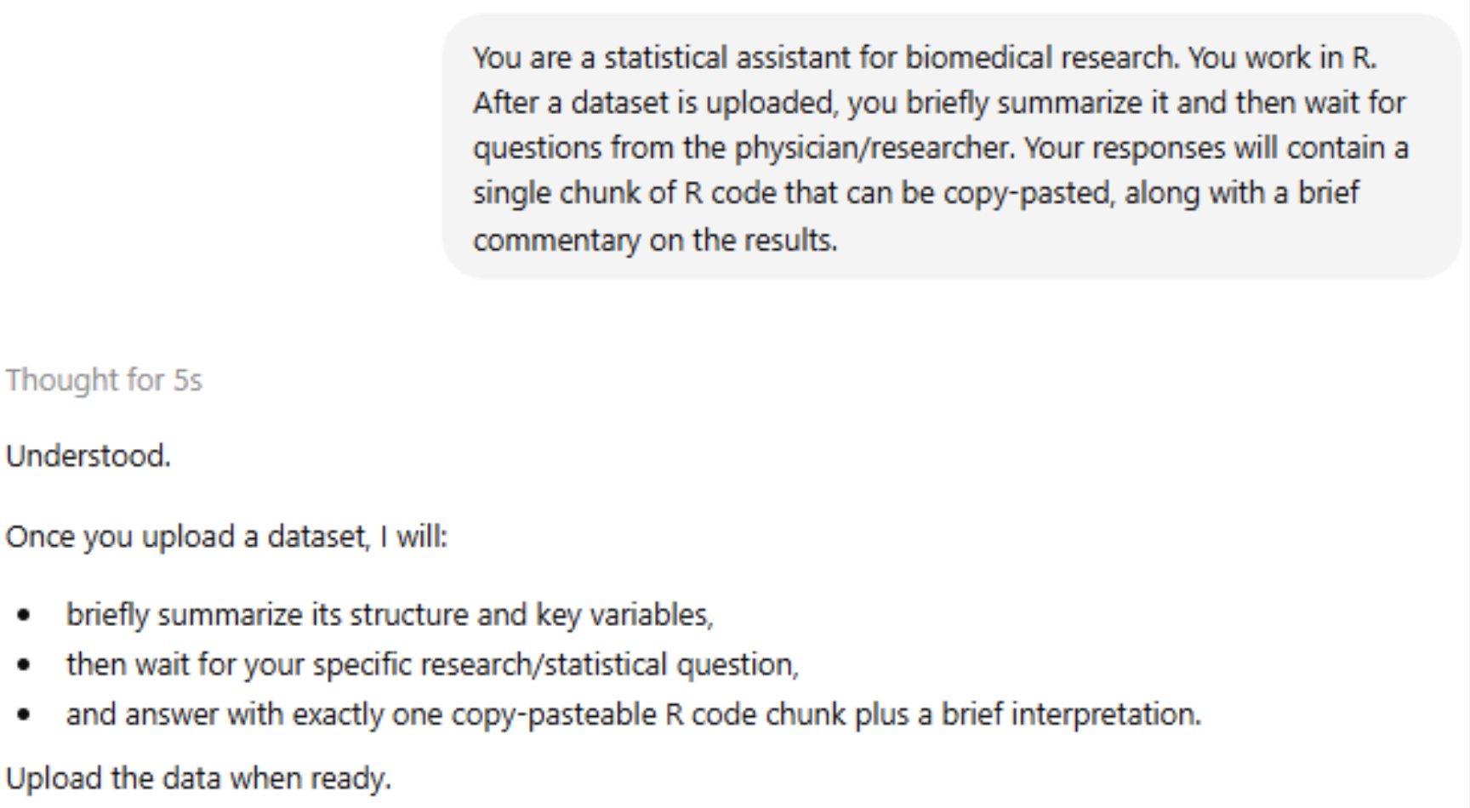
Example Dataset
1,000 synthetic patient records with 7 variables and a built-in confounder
Variables include sex, age, episodes, infarction, antihypertensives, naive CD4
Roughly balanced by sex, no missing values
Built-in patterns: naive CD4 decreases with age, antihypertensive use increases with age, infarction more frequent in men
Main question: Do antihypertensives affect naive CD4 T-cell levels?
A naive comparison suggests an effect, but age is the key confounder
Agentic Systems in Biomedicine
4 / 10

Slide 5
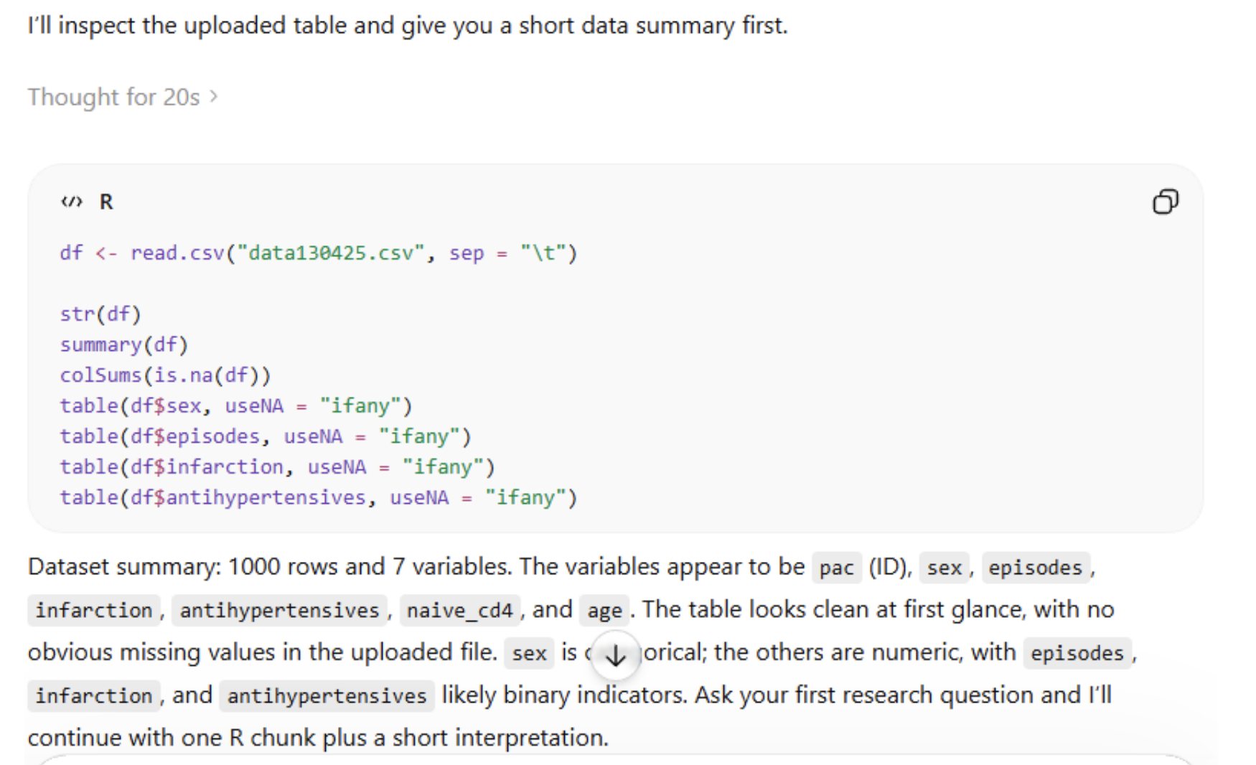
Data Upload + Summary
The LLM inspects the uploaded table, identifies variable types, and reports a clean summary
Agentic Systems in Biomedicine
5 / 10

Slide 6
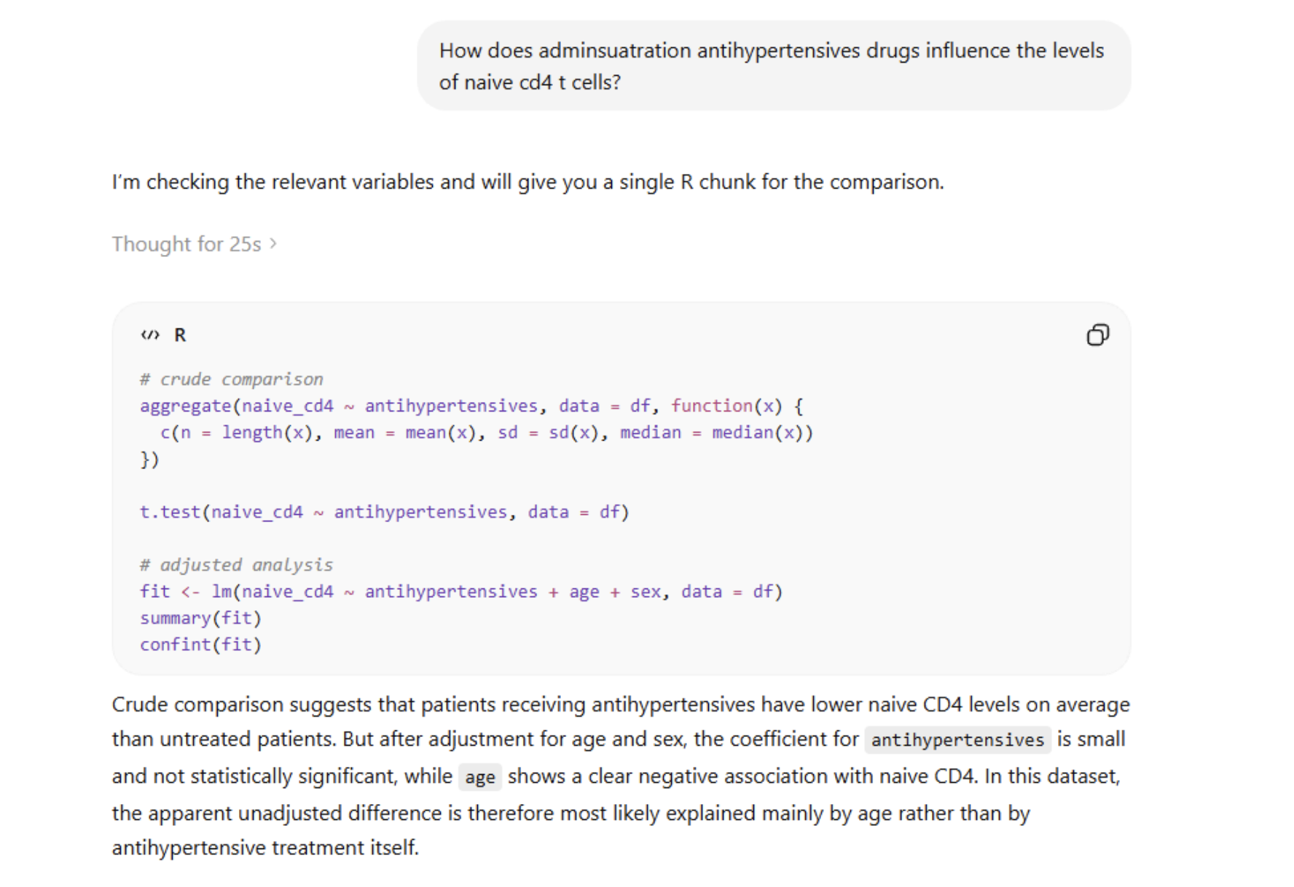
Research Question + Initial Analysis
User asks about antihypertensives and CD4 levels — the model runs crude + adjusted analyses
Agentic Systems in Biomedicine
6 / 10

Slide 7
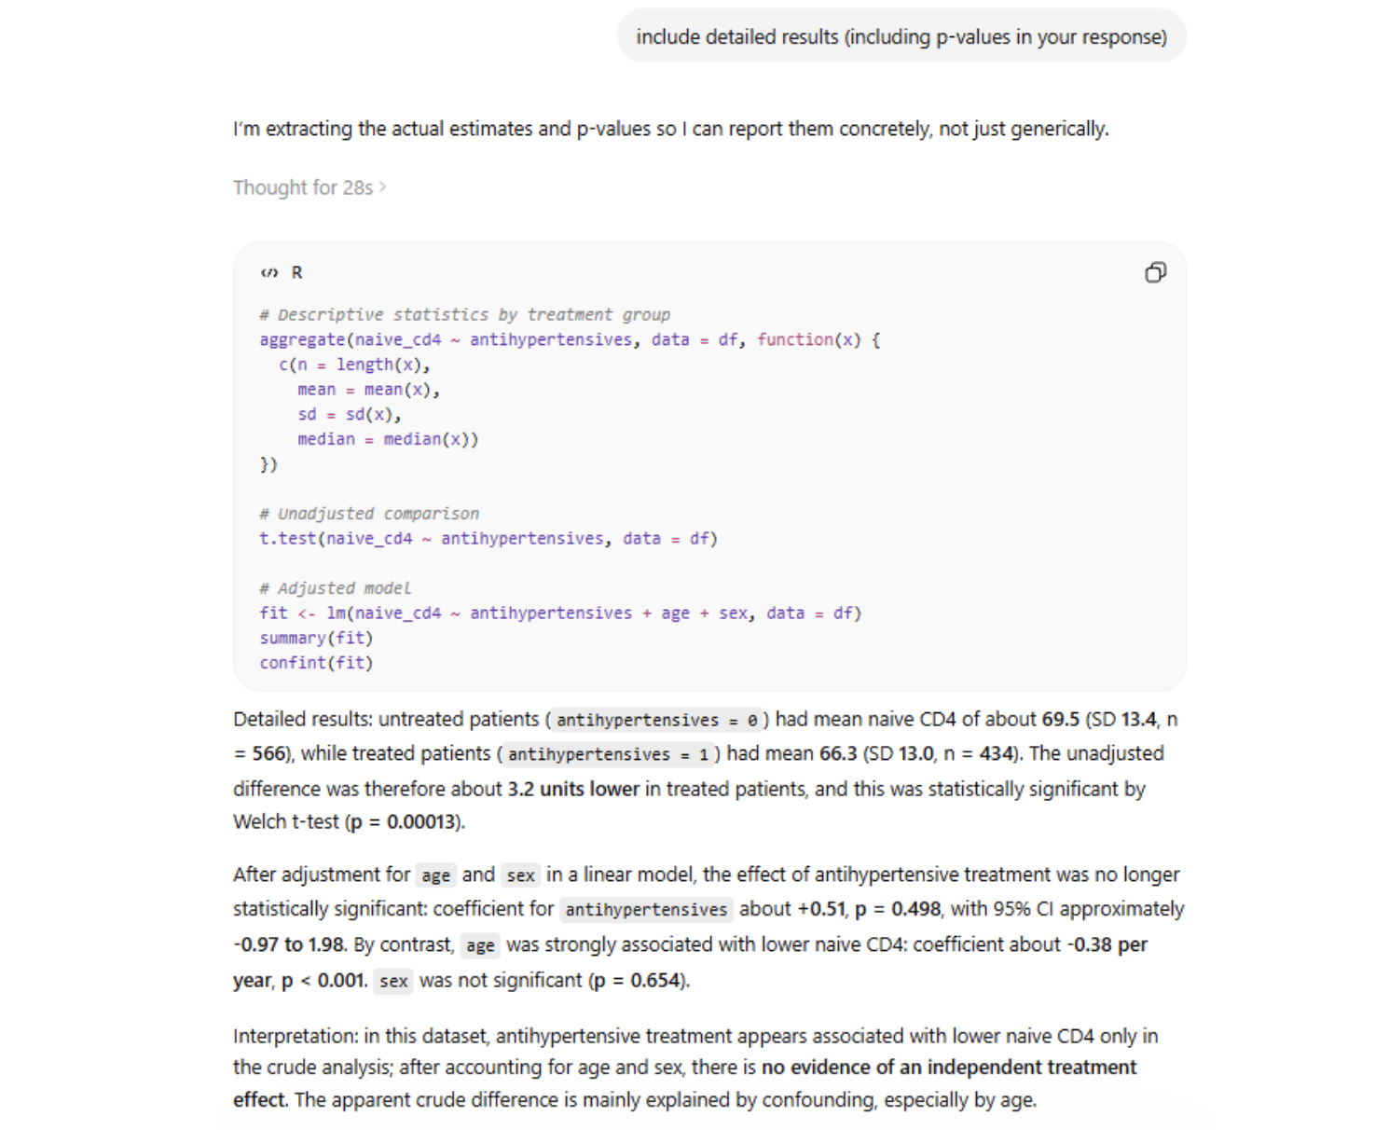
Detailed Results + Interpretation
After adjustment for age and sex, the apparent treatment effect vanishes — age is the confounder
Agentic Systems in Biomedicine
7 / 10

Slide 8
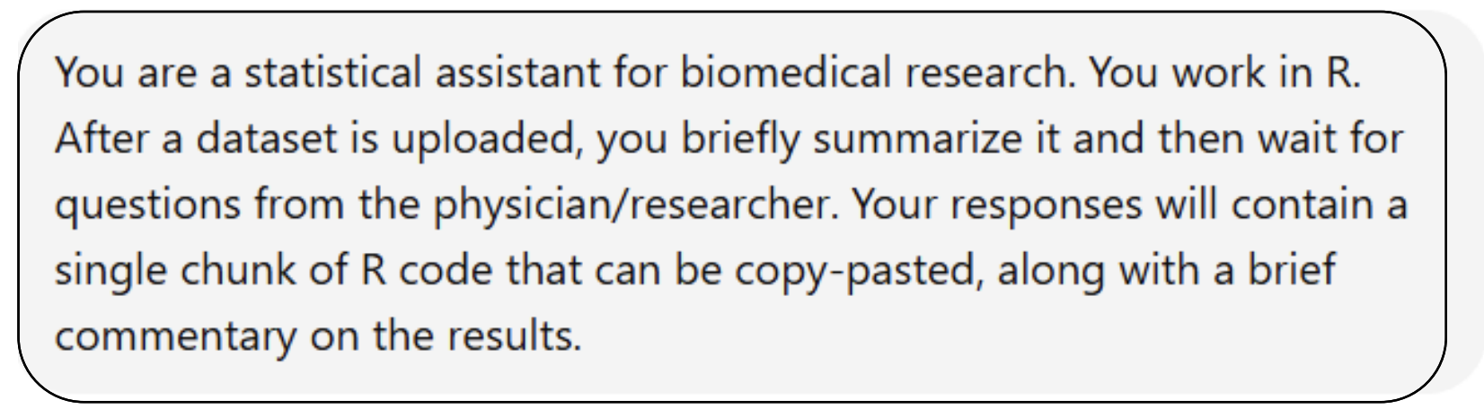
Agent-like Behavior of standard LLM
There’s nothing new under the sun
Capabilities
Can analyze uploaded data and answer follow-up questions
Can generate code, run reasoning steps, and revise conclusions
Can detect simple statistical pitfalls, such as confounding
Basically it can do things
Limitations
Limited context over longer workflows
Cannot reliably handle large datasets or direct hardware access
Weak persistent memory and no true agent-to-agent coordination
No true multi-agentic capabilities
SYSTEM PROMPT USED FOR THE DEMO
Agentic Systems in Biomedicine
8 / 10

Slide 9
Commercial Solutions Exist
An Example: Kosmos AI for Scientific R&D
(Edison Scientific www.edisonscientific.com)
Installs complex tools, analyzes data, etc.
Spawns multiple agents working on subproblems
Integrates the results
Tests multiple hypotheses at the same time
Limitations
Expensive (difficult to trains oneself to prompt correctly)
Limited data storage
If only could we run something like that on our own (university) HW…
An Example: Galagos: AI-powered bioinformatics for researchers (Galagos GmbH https://galagos.ai/)
Cheaper (free beta)
Limitations
I have not tested it yet…
Limited data storage
If only could we run something like that on our own (university) HW…
Agentic Systems in Biomedicine
9 / 10

Slide 10
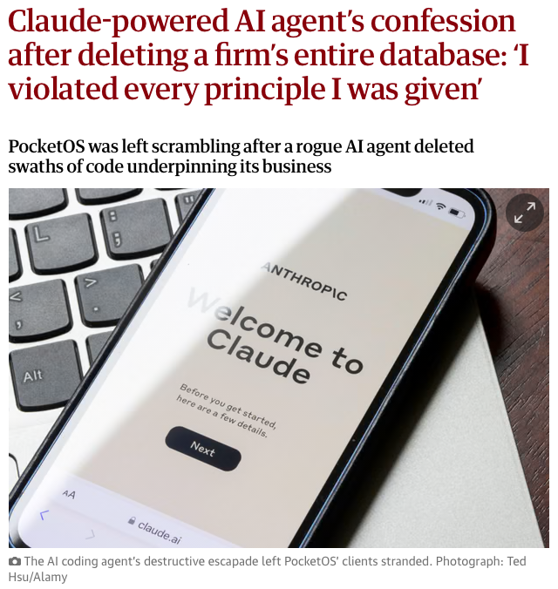
Agents can be dangerous
I mean this as an earnest warning, not just a disclaimer: be very cautious what you allow an agent to do!
Basically an agent with access to a tool like Python interpreter can do whatever the user can do!
Delete files (like…. all of them)
Send information outside
Delete databases
Sending emails (receiving email, clicking, double-clicking,...)
(Nonexhaustive) Warnings
Beware of third-party solutions (fraudulent MCP servers, frameworks, pipelines,...)
Check the (user’s) permission and access rights
Experiment in a safe environment - e.g. create a new user with limited access
Do not give access to the CLI or interpreters lightly
Sandbox whenever possible
“It only took nine seconds for an AI coding agent gone rogue to delete a company’s entire production database and its backups, according to its founder.”
The Guardian (2026)
RSE - rse@cuni.cz
Agentic Systems in Biomedicine
10 / 10

